Slide 1
Qualitative Analysis Сase of Multi-Label Text Classification in Humanitarian Affairs
Bohdan Pelekh
Fedir Zhurba

Slide 2


Idea
Project Objective:
Research methods and practises for qualitative analysis.
Build a multi-class, multi-label text classification models tailored for NLP challenges.
Automate the categorization of complex, hierarchical annotations and qualitative data.
Use state-of-the-art transformer models to address real-world NLP problems such as multilingual data, long document handling, and hierarchical label structures.
Why It’s Important:
Pushes the boundaries of NLP applications, allows convert qualitative data in quantitative format.
Enhances response on qualitative texts by automating document analysis at scale.

Slide 3
Dataset
HumSet – NLP Dataset for Humanitarian Text Classification
Focus: English-only documents, texts UP TO 512 tokens
Annotations: Multi-class, multi-label tags.
Size: ~80.000 data entries in the train dataset, ~10.000 in the test dataset

Slide 4
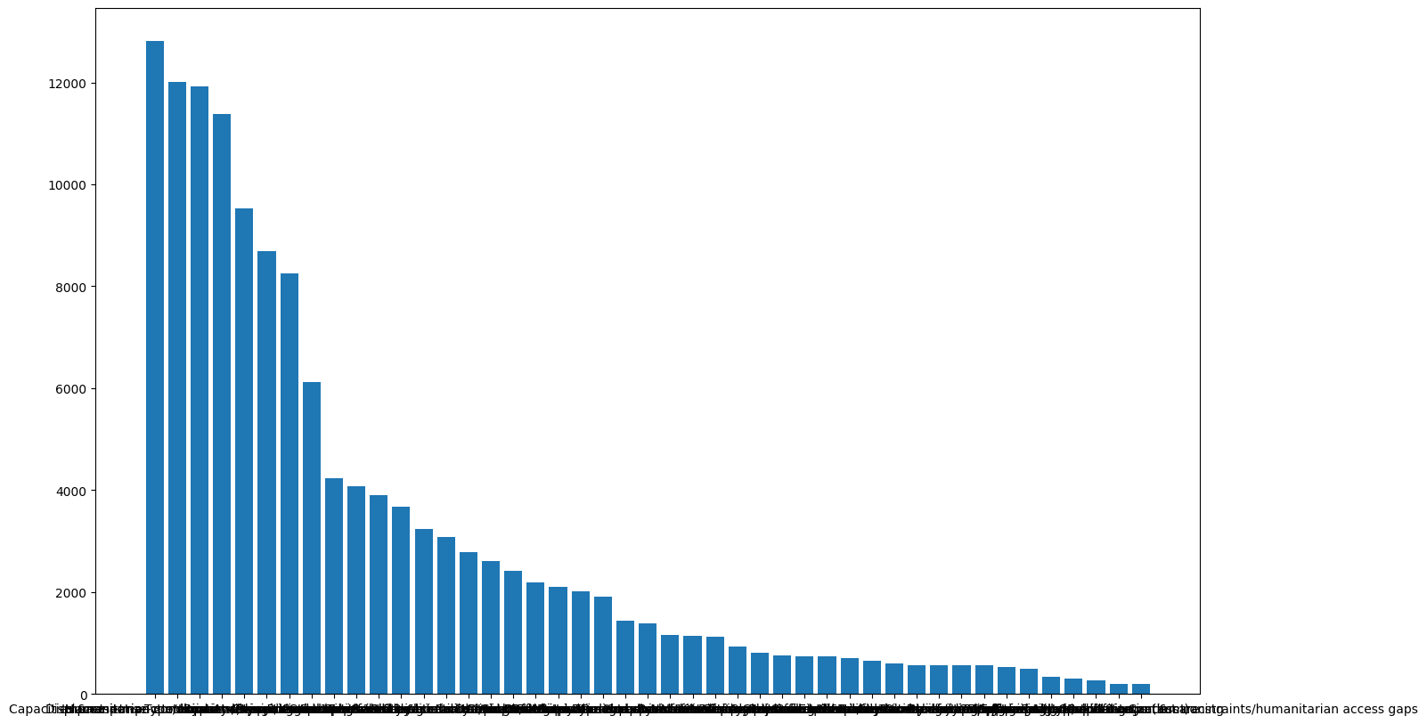
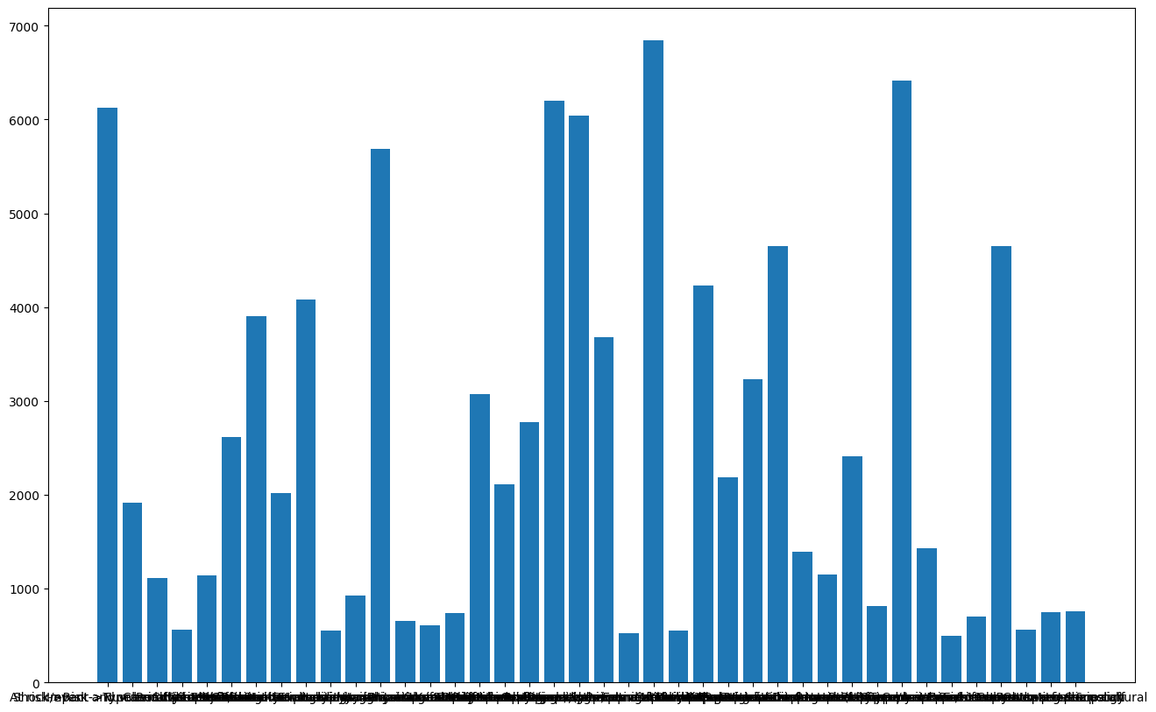
Data normalization
Label Refinement
Rare Label Removal
Common Label Reduction
40 Classes

Slide 5
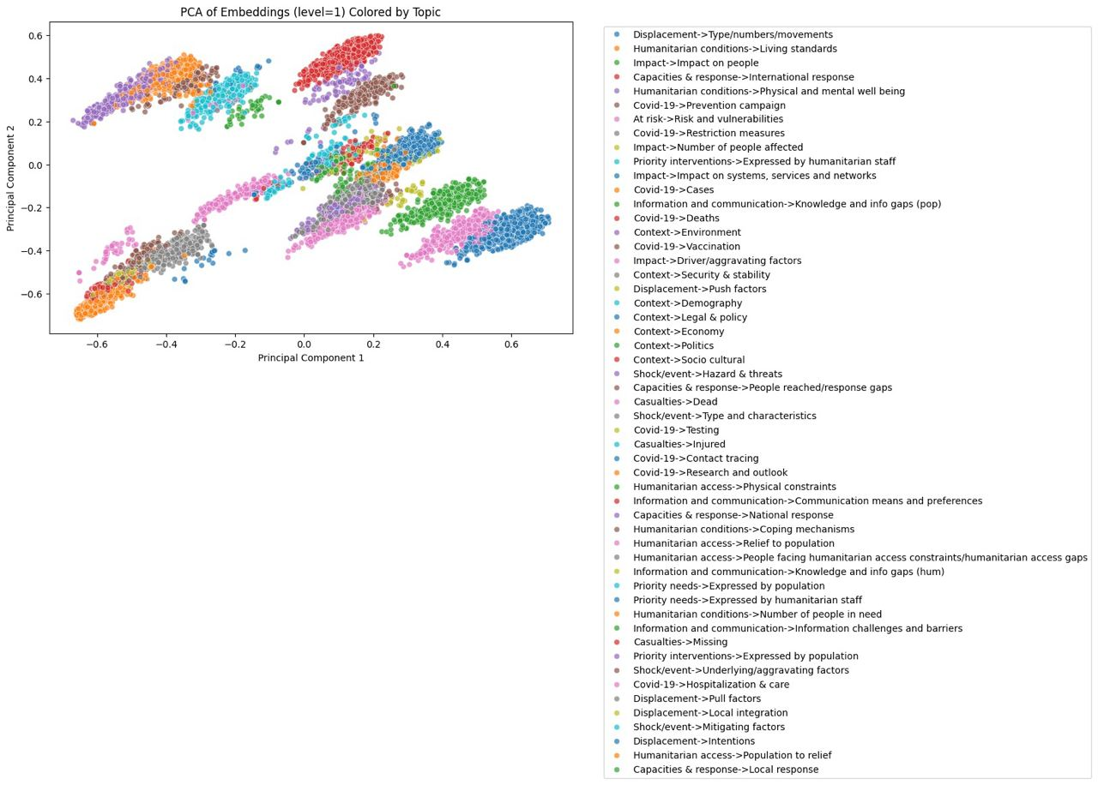
SVM

Slide 6
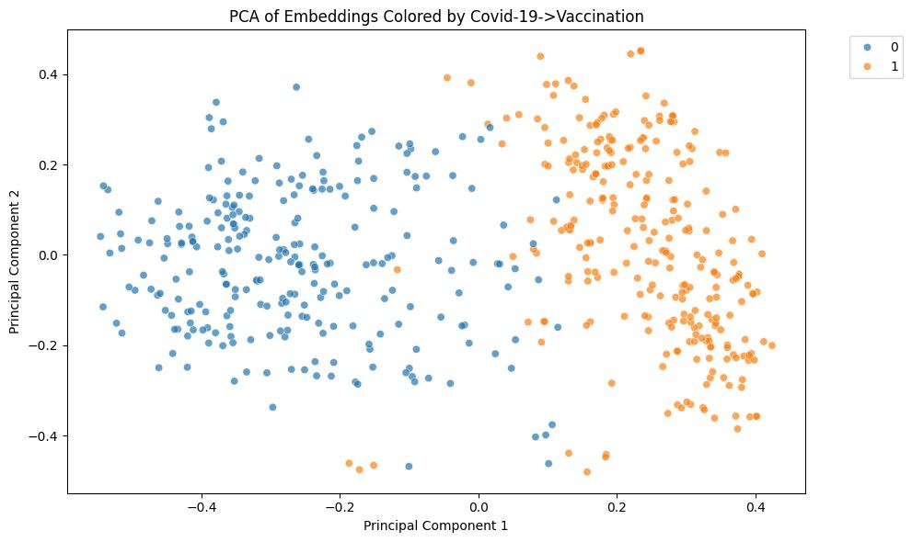
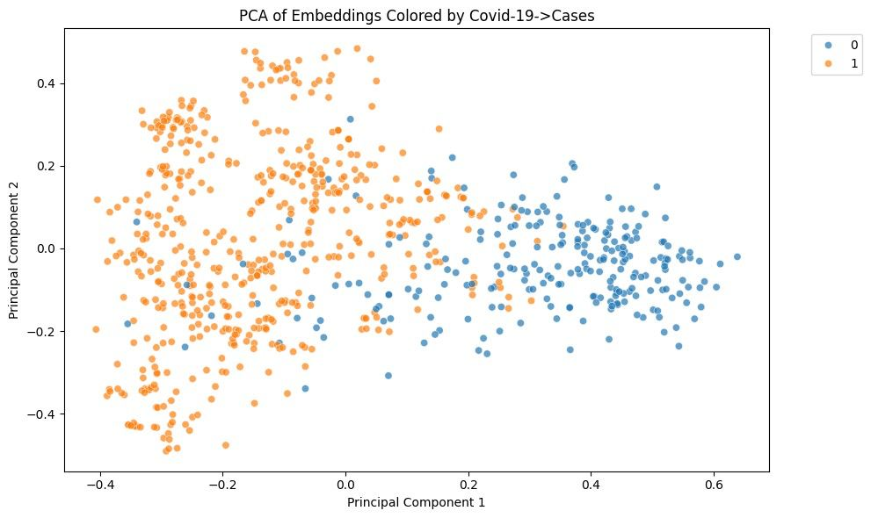
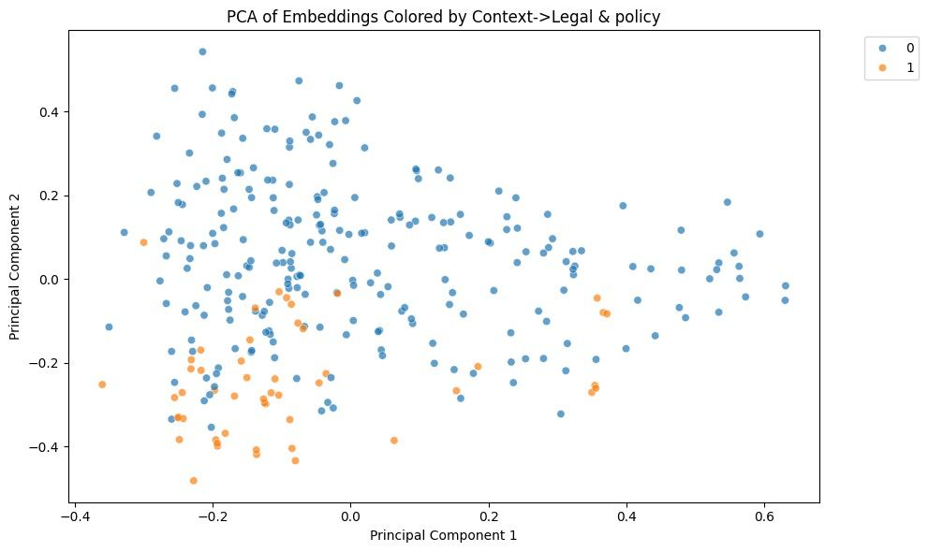
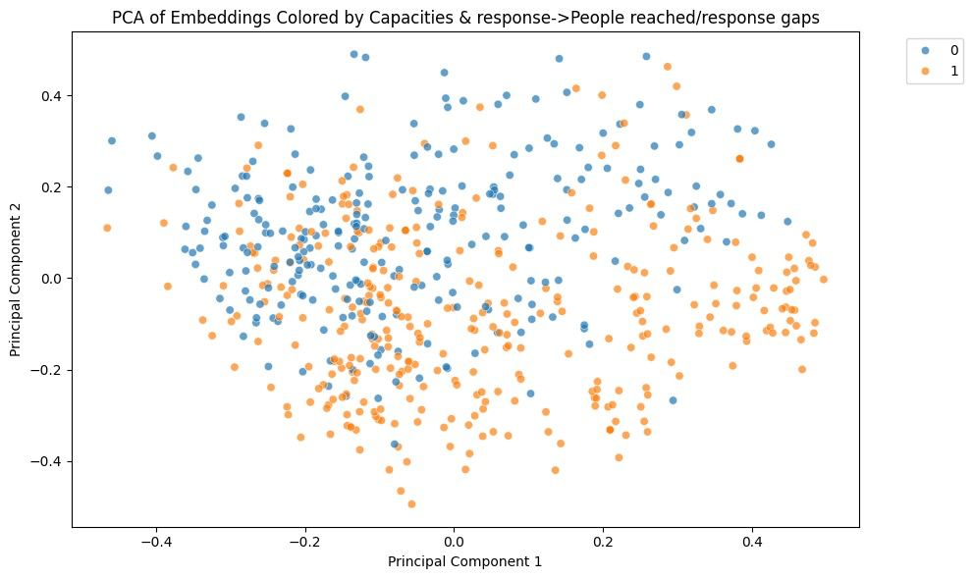
SVM, labels distribution

Slide 7
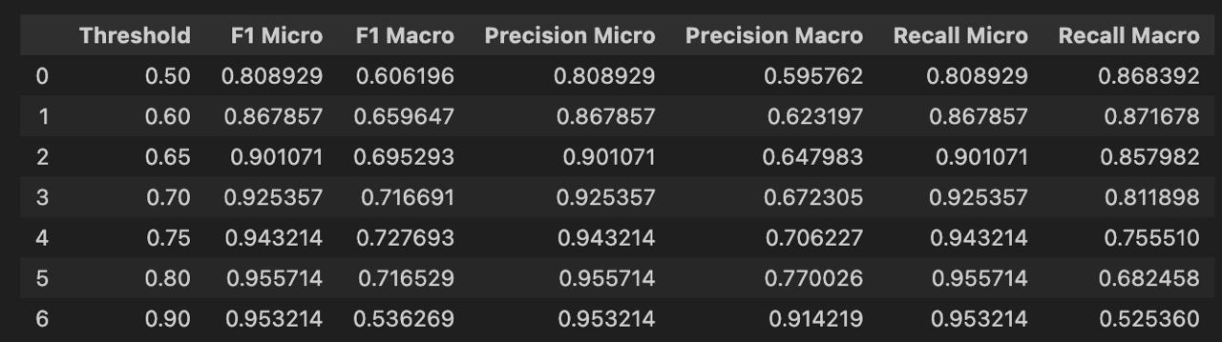
SVM results

Slide 8
Berta (bert-base-uncased)
Full-training on 7 epochs
Multi-labeled
Sigmoid activation
Multi-hot encoding
110 mln. parameters

Slide 9
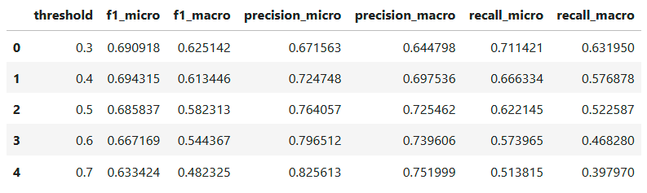
Threshold tuning

Slide 10
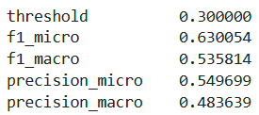

Test set evaluation
Task may be complicated due to variety of classes and uneven distribution.

Slide 11
GPT p1
Topics detection
Topics matching

Slide 12
GPT p2
Topics detection
Topics matching

Slide 13
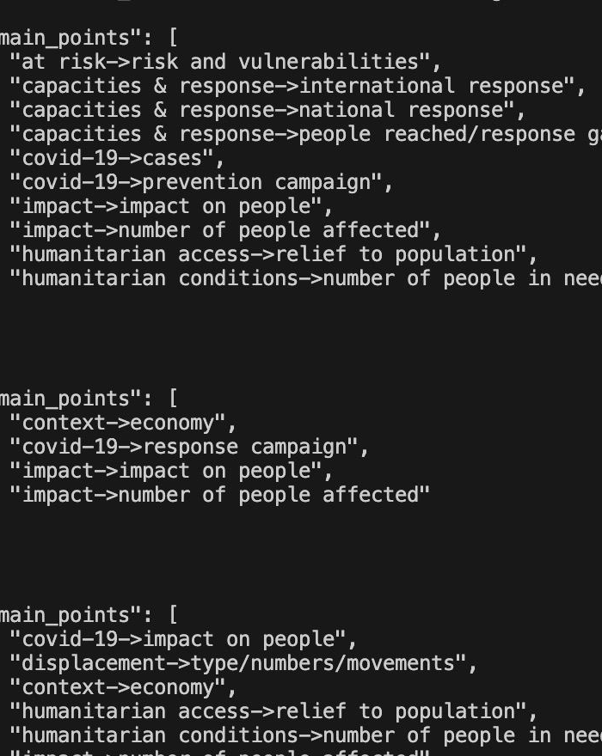
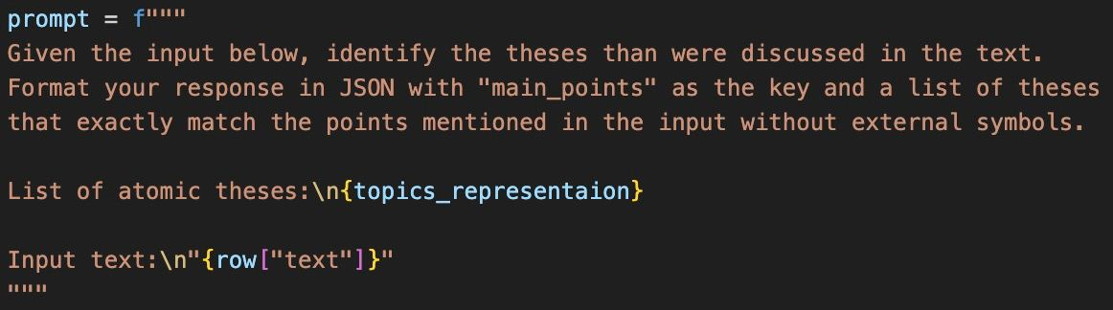
GPT p3

Slide 14
Demo

